Slide 1

Streaming Data from Kafka
using Structured Streaming in Azure Databricks

Slide 2
Overview
The POC involved creating a data pipeline to stream data from Kafka Confluent into Delta Lake tables in Databricks.
The goal was to demonstrate real-time reporting and analytics.
Delta Live Tables are used for creating robust ETL pipelines.
Use of Power BI to create interactive dashboards and visualizations to monitor key metrics in real-time.

Slide 3
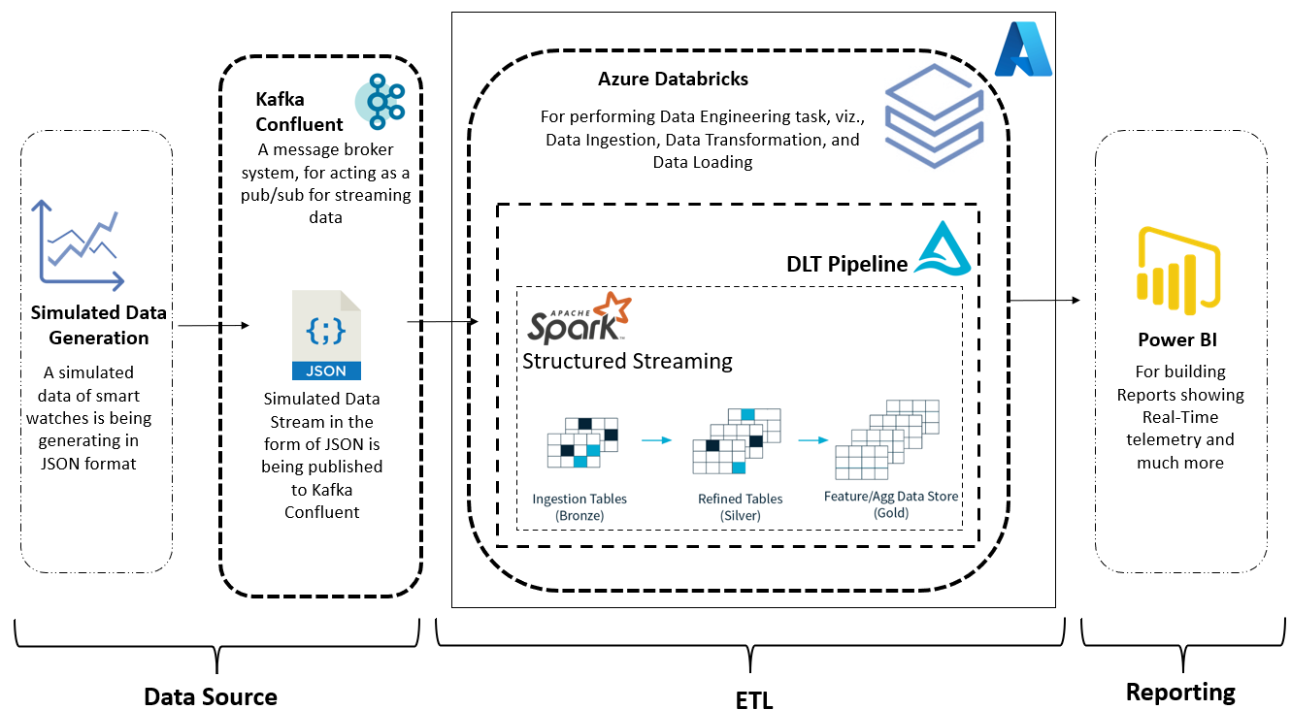
Architecture

Slide 4
Data Source
Kafka Confluent is a distributed streaming platform built on top of Apache Kafka.
It enables real-time data processing and streaming at scale.
Kafka Confluent provides features such as multi-datacenter replication, automatic failover, role-based access control, and monitoring and management tools.
It simplifies the process of managing complex data streams and enables real-time insights for informed decisions.
Kafka Confluent has become a popular choice for companies handling high volumes of real-time data.

Slide 5
Extract, Transform and Load
1. Structured Streaming in Databricks enables real-time processing of large amounts of data, while guaranteeing low latency and high reliability. It is a valuable tool for data engineers and data scientists who need to process data continuously.
2. Delta Live Tables is a critical component of Delta Lake, offering ACID guarantees and real-time data processing and ingestion. It eliminates the need for batch processing, making it easier to handle large amounts of data.
3. Delta Live Tables and Structured Streaming enable us to process Kafka Confluent data in real-time and write it to Delta Lake tables, providing actionable insights that make businesses more agile and responsive to changes.

Slide 6
Reporting
Power BI was used for real-time monitoring and analysis of critical metrics.
Power BI connected to Delta Lake tables in Databricks for data visualization.
Custom visuals and reports were created for real-time performance measurement.
Interactive dashboards helped in identifying trends and forecasting future performance.
Power BI played a critical role in achieving the project objectives by providing real-time insights and visualizations.

Slide 7
Thank You

